Slide 1
Unit Test Training
Version: 2.0
Author: Nguyen Thi Lan Huong
Duong Thanh Nhan
Update: Nguyen Thu Huong
Mai Minh Hai
Le Van Hoc
Dang Dieu Linh
Vu Tien Dat
Instructor:

Slide 2
Introduction
Agenda(90 minutes)
  Unit Test - What and Who?
  Unit Test - Why?
  Unit Test - How? (method, technique)
  Unit Test - Practice (3-5 labs) + Answer
Purpose: Practical Guide to Software Unit Testing
Targeted attendees: Developers, Tester, SQA

Slide 3
Objectives
The course helps attendees understand:
  Unit Test Fundamentals: Answer the question of what, why, when and how to do unit test
  Unit Test Technique: Introduce approaches and techniques to do unit test

Slide 4
Unit Test – What and Who ?
  Unit Testing Actions:
    Validate that individual units of software program are working properly
    A unit is the smallest testable part of an application (In procedural programming a unit may be an individual program, function, procedure, etc., while in object-oriented programming, the smallest unit is always a method)
    Units are distinguished from modules in that modules are typically made up of units
  Unit Testing Deliverables:
    Tested software units
    Related documents (Unit Test case, Unit Test Report)
  Unit Testing Conductor: Development team

Slide 5
Unit Test – Why ?
  Ensure quality of software unit
  Detect defects and issues early
  Reduce the Quality Effort & Correction Cost

Slide 6
Cost of bugs
$14,000
85%
% Defects
Introduced in
this phase
% Defects
found in
in this phase
Percentage of Bugs
$1000
$ Cost to
repair defect
in this phase
$130
$250
$25
Coding
Unit
Test
Funct
Test
Field
Test
Post
Release
Source: Applied Software Measurement,
Capers Jones, 1996

Slide 7
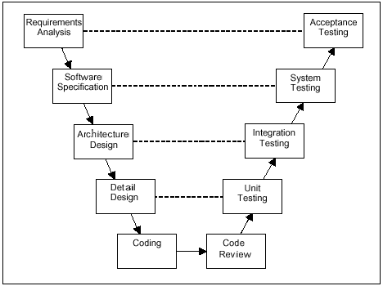
Unit Test – When ?
  After Coding
  Before Integration Test

Slide 8
Unit Test – How ?(1) Methodologies
UT processes
  Follow the UT process defined in FSOFT UT Guidelines

Slide 9
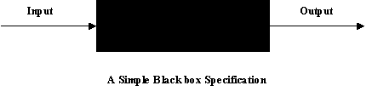
Unit Test – How ?(2) Methodologies
Black-box testing
  Functional testing: ensure each unit acts right as its design
  Business testing: ensure the software program acts right as user requirement

Slide 10

Unit Test – How ?(3) Methodologies
White-box testing
  Developer does himself
    Check syntax of code by compiler to avoid syntax errors
    Run code in debug mode, line by line, through all independent paths of program to ensure that all statement of codes has been executed at least one time
    Examine local data structure to ensure that data stored temporarily maintains its integrity during all all steps of code execution
    Check boundary conditions to ensure that code will run properly at the boundaries established as requirements
    Review all error handling paths
  Apply WB Test techniques
    See next slides

Slide 11
Unit Test – How ? Techniques
Black box test (Functional)
  Specification derived tests
  Equivalence partitioning
  Boundary value analysis
White box (Structural)
  Statement coverage
  Decision (branch) coverage
  Path coverage

Slide 12
Black box test – Specification derived test
You can choose all or some statements in the specification of software
Create test cases for each statements of specification
Execute test cases to check test result will output as the specification

Slide 13
Example Specification
  Input - real number
  Output - real number
When given an input of 0 or greater, the positive square root of the input shall be returned.
When given an input of less than 0, the error message "Square root error - illegal negative input" shall be displayed and a value of 0 returned.

Slide 14
Example Test Cases
Test Case 1: Input 4, Return 2
    Use the first statement in the specification
    ("When given an input of 0 or greater, the positive square root of the input shall be returned.").
Test Case 2: Input -10, Return 0, Output "Square root error - illegal negative input“
    Use the second and third statements in the specification
    ("When given an input of less than 0, the error message "Square root error - illegal negative input" shall be displayed and a value of 0 returned.”).

Slide 15
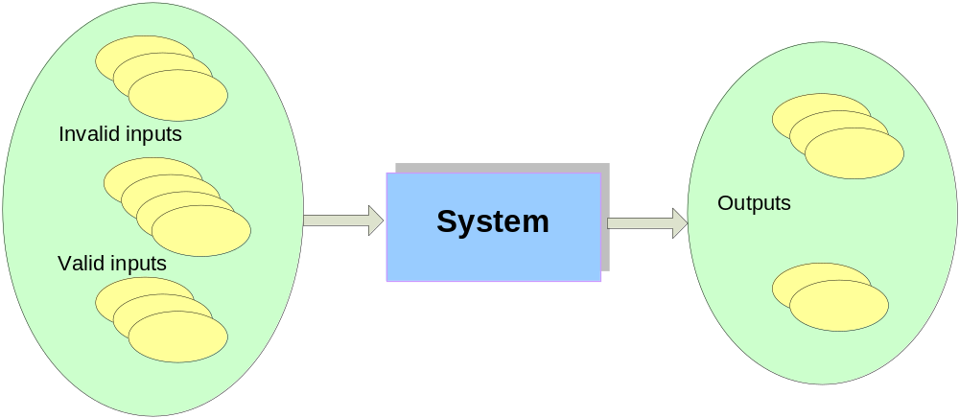
Black box test: Equivalence partitioning
Divide the input of a program into classes of data from which test cases can be derived. This might help you to reduce number of test cases that must be developed.
Behavior of software is equivalent for any value within particular partition
A limited number of representative test cases should be chosen from each partition

Slide 16
Example Test Cases
Input partitions |  | Output partitions
1 | >= 0 | a | >= 0
2 | < 0 | b | Error
Test Case 1: Input 4, Return 2
    Use the >=0 input partition (1)
    Use the >=0 output partition (a)
Test Case 2: Input -10, Return 0, Output "Square root error - illegal negative input“
    Use the < 0 input partition (2)
    Use the “Error” output partition (b)

Slide 17
Black box test: Boundary value analysis
It is similar to equivalence partitioning, is a selection of test cases, test input that check bounding values
Anticipate that errors are most likely to exist at the boundaries between partitions
Test the software at either side of boundary values

Slide 18
Example Test Cases
Input partitions |  | Output partitions
1 | >= 0 | a | >= 0
2 | < 0 | b | Error
Input Partitions (1) (2) - 0 + 1 2 3 4 5 Boundaries and test cases

Slide 19
White box test : Node
Example:
  buy(dress, bag) {
  if dress already in bag
  display “already bought it”
  else
  if bag is full
  display “bag is full”
  else
  buy dress
  display “buy successful”
  end if
  end if
  }
A
A
B
B
C
C
D
D
E
E
F
F
G
G

Slide 20
White box test: Statement coverage
Total Nodes = 7;
Test case ABG covers 3 = 43%
+
Test case ACDFG
Now covers 6/7 = 86%
Need 1 more for 100% statement coverage – ACEFG
A
A
C
B
C
B
D
D
E
E
F
F
G
G

Slide 21
White box test: Decision (branch) coverage
A
A
What branch coverage is achieved by ABG, ACDFG, ACEFG?
4 in total.
4 covered
So 4/4 = 100% branch coverage
C
B
C
B
D
D
E
E
F
F
G
G

Slide 22
White box test: Path coverage
A
A
What path coverage is achieved by ABG, ACDFG, ACEFG?
3 in total.
3 covered
So 3/3 = 100% path coverage
C
B
C
B
D
D
E
E
F
F
G
G

Slide 23
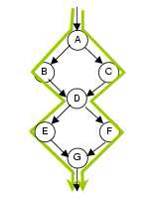
Example: White box test case
Test cases covering ABDEG and ACDFG cover 4/4 branches (100%) and 7/7 statements (100%)
They, however, only cover 2/4 paths (50%).
2 more tests are required to achieve 100% path coverage
  ABDFG
  ACDEG

Slide 24
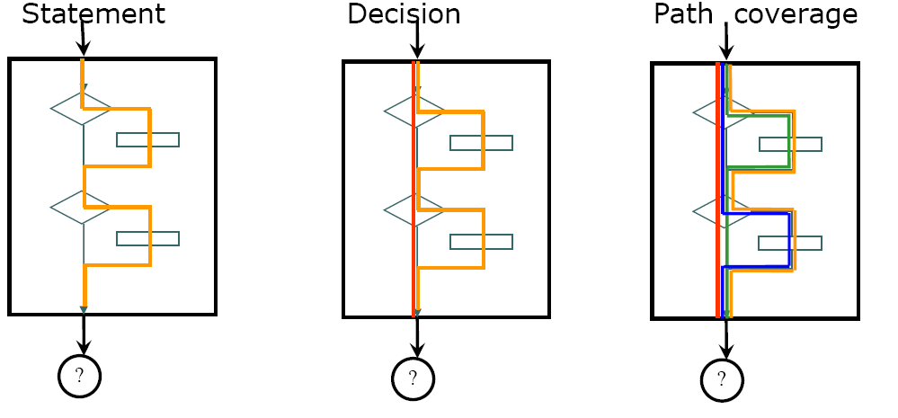
White box test: Comparison

Slide 25
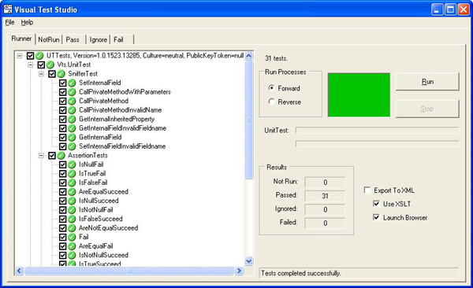
Unit Testing Tools
UT Tools for references:
  Java: JUnit, J2MEUnit
  C/C++: cppUnit
  Python: pyUnit
  Perl: PerlUnit
  Visual Basic: vbUnit
  C# .NET: Nunit,csUnit
Refferences:
  http://www.testingfaqs.org/t-unit.html
  www.junit.org
  http://www.codeproject.com/gen/design/autp5.asp

Slide 26
Quizzes
You find bugs while coding, is it unit test activity? Why?
Which cases we apply Black-box and White-box testing?
What are the result if we do not perform Unit test?
As your opinion, What is the most difficult in Unit test activity?
What are the products of Unit test activity?
(Good question from student)
(6 coupons)

